Slide 1





TEAM
Shreeprabha Aggarwal (sa10g10)
Cathy Jin (cj8g10)
Karishma Nune (kkn1g10)
Carolina Ferreira (cf4g09)
SUPERVISOR
Gary Wills (gbw)
CUSTOMER
David Argles, Haven Consulting
Kate Bittles, IBM
GDP 9 A Raspberry Pi Control Kit For Teaching

Slide 2
Presentation Outline
1
Introduction
2
Goals
3
CECIL
4
GUI
Design
5
Project
Management
6
Next
Steps

Slide 3

Introduction
Aim
Application for teaching hardware
Development platform
Hardware: Raspberry Pi
Software: CECIL

Slide 4
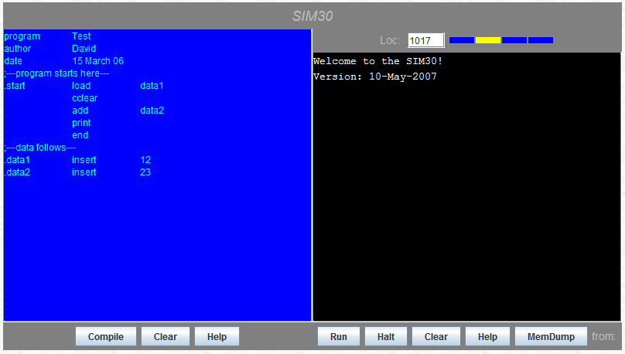
Current CECIL Interface

Slide 5
Goals
Deliverables
User friendly interface
CECIL integrated with Raspberry Pi
Read and load from physical I/O ports
Constraints
No heavy hardware or electronic implementations
Notes:
to facilitate teaching and learning of computer architecture and make it enjoyable

Slide 6
CECIL I
Simple assembly language
Grammar
Lexer, parser, compiler

Slide 7
CECIL II
Virtual machine
SIM40 processor
1 KB memory
I/O Ports
interactive LED display
transferring data through USB
Virtual processor
Program counter
Three registers
X - Register
Y - Register
Accumulator
Status flags
zero, carry, negative
Instruction set
Simple operations like add, sub, insert, load, comp
Use these to construct sub-routines like loop and if-else

Slide 8
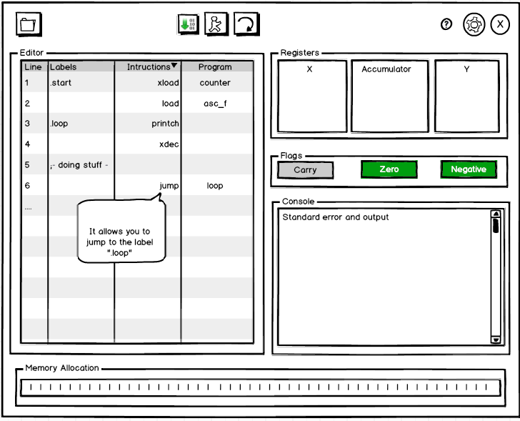
GUI Design

Slide 9
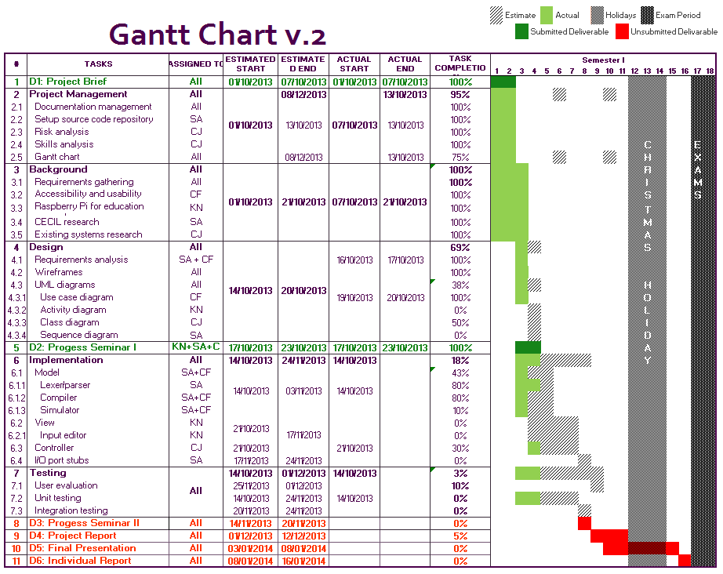
Project Management

Slide 10
Next Steps
Finish implementation
Develop a working prototype by week 7
End user evaluation
Evaluation with teachers and students

Slide 11
Thank You
Any Questions?

